Slide 1
Experiment Framework (Assumes background on BPP network)
Low-Cost electrochemical gas sensors are not robust against drift and cross-sensitivity; they require frequent calibration and degradation monitoring. Lab calibration is not effective or practical [cite].
Winter et. al. here describe distributed calibration procedure that is shown to be effective in the short-term.
Same authors here describe an effective method for characterizing sensor drift and degradation in long-term deployments.
BPP’s network is constrained by a lack of reference sensors (one to two active across the lifetime of the network).
Under this constraint, this project builds on the Winter et. al. drift characterization framework by comparing current sensor data with past data from the same sensor and measuring trends in distribution divergence.

Slide 2
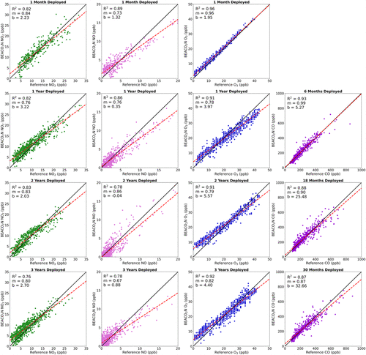
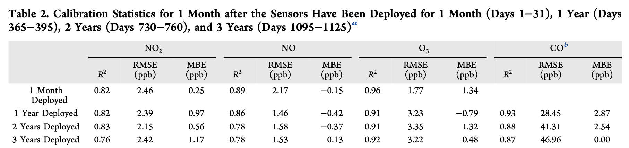
Winter et. al. Drift Characterization Framework
Authors cite that short-term calibration is well-studied but does not lend insight to sensor performance across years or seasons. Understanding LCS degradation is important for data quality assurance.
Authors compare the simultaneous sensor output of a representative BEACO2N sensor with a collocated reference-grade air quality monitor at San Pablo. This site was chosen because the BEACO2N sensor at that site was the longest-operating and longest-collocated sensor in that network.
Authors examine residual trendlines at 1, 12, 24, and 36 months after deployment (6, 18, 30 mos for CO) and report regression statistics.

Slide 3
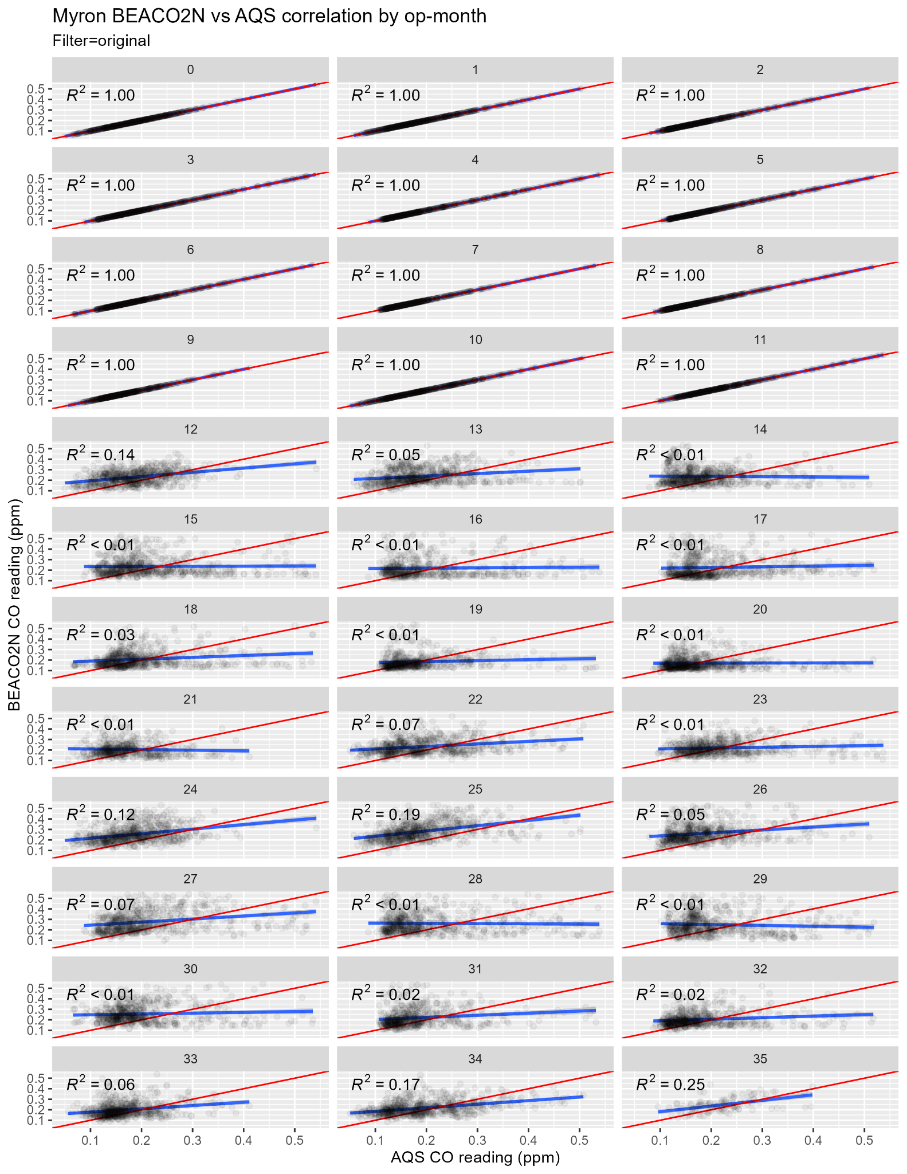
Breathe Providence Network Constraints
The Winter framework is reliant on continuous reference data for the lifetime of the sensor to compare a residual trendline. Currently Providence County has one operative reference sensor in Cranston, RI and no sensors with a continuous stream of collocated reference data.
This leaves other low cost sensors as the only source for distributed data collection, however these are the sensors whose reliability we are trying to characterize.
Additionally if we want to measure degradation compared to self, we cannot expect a one-to-one residual correlation for a given month over time.

Slide 4
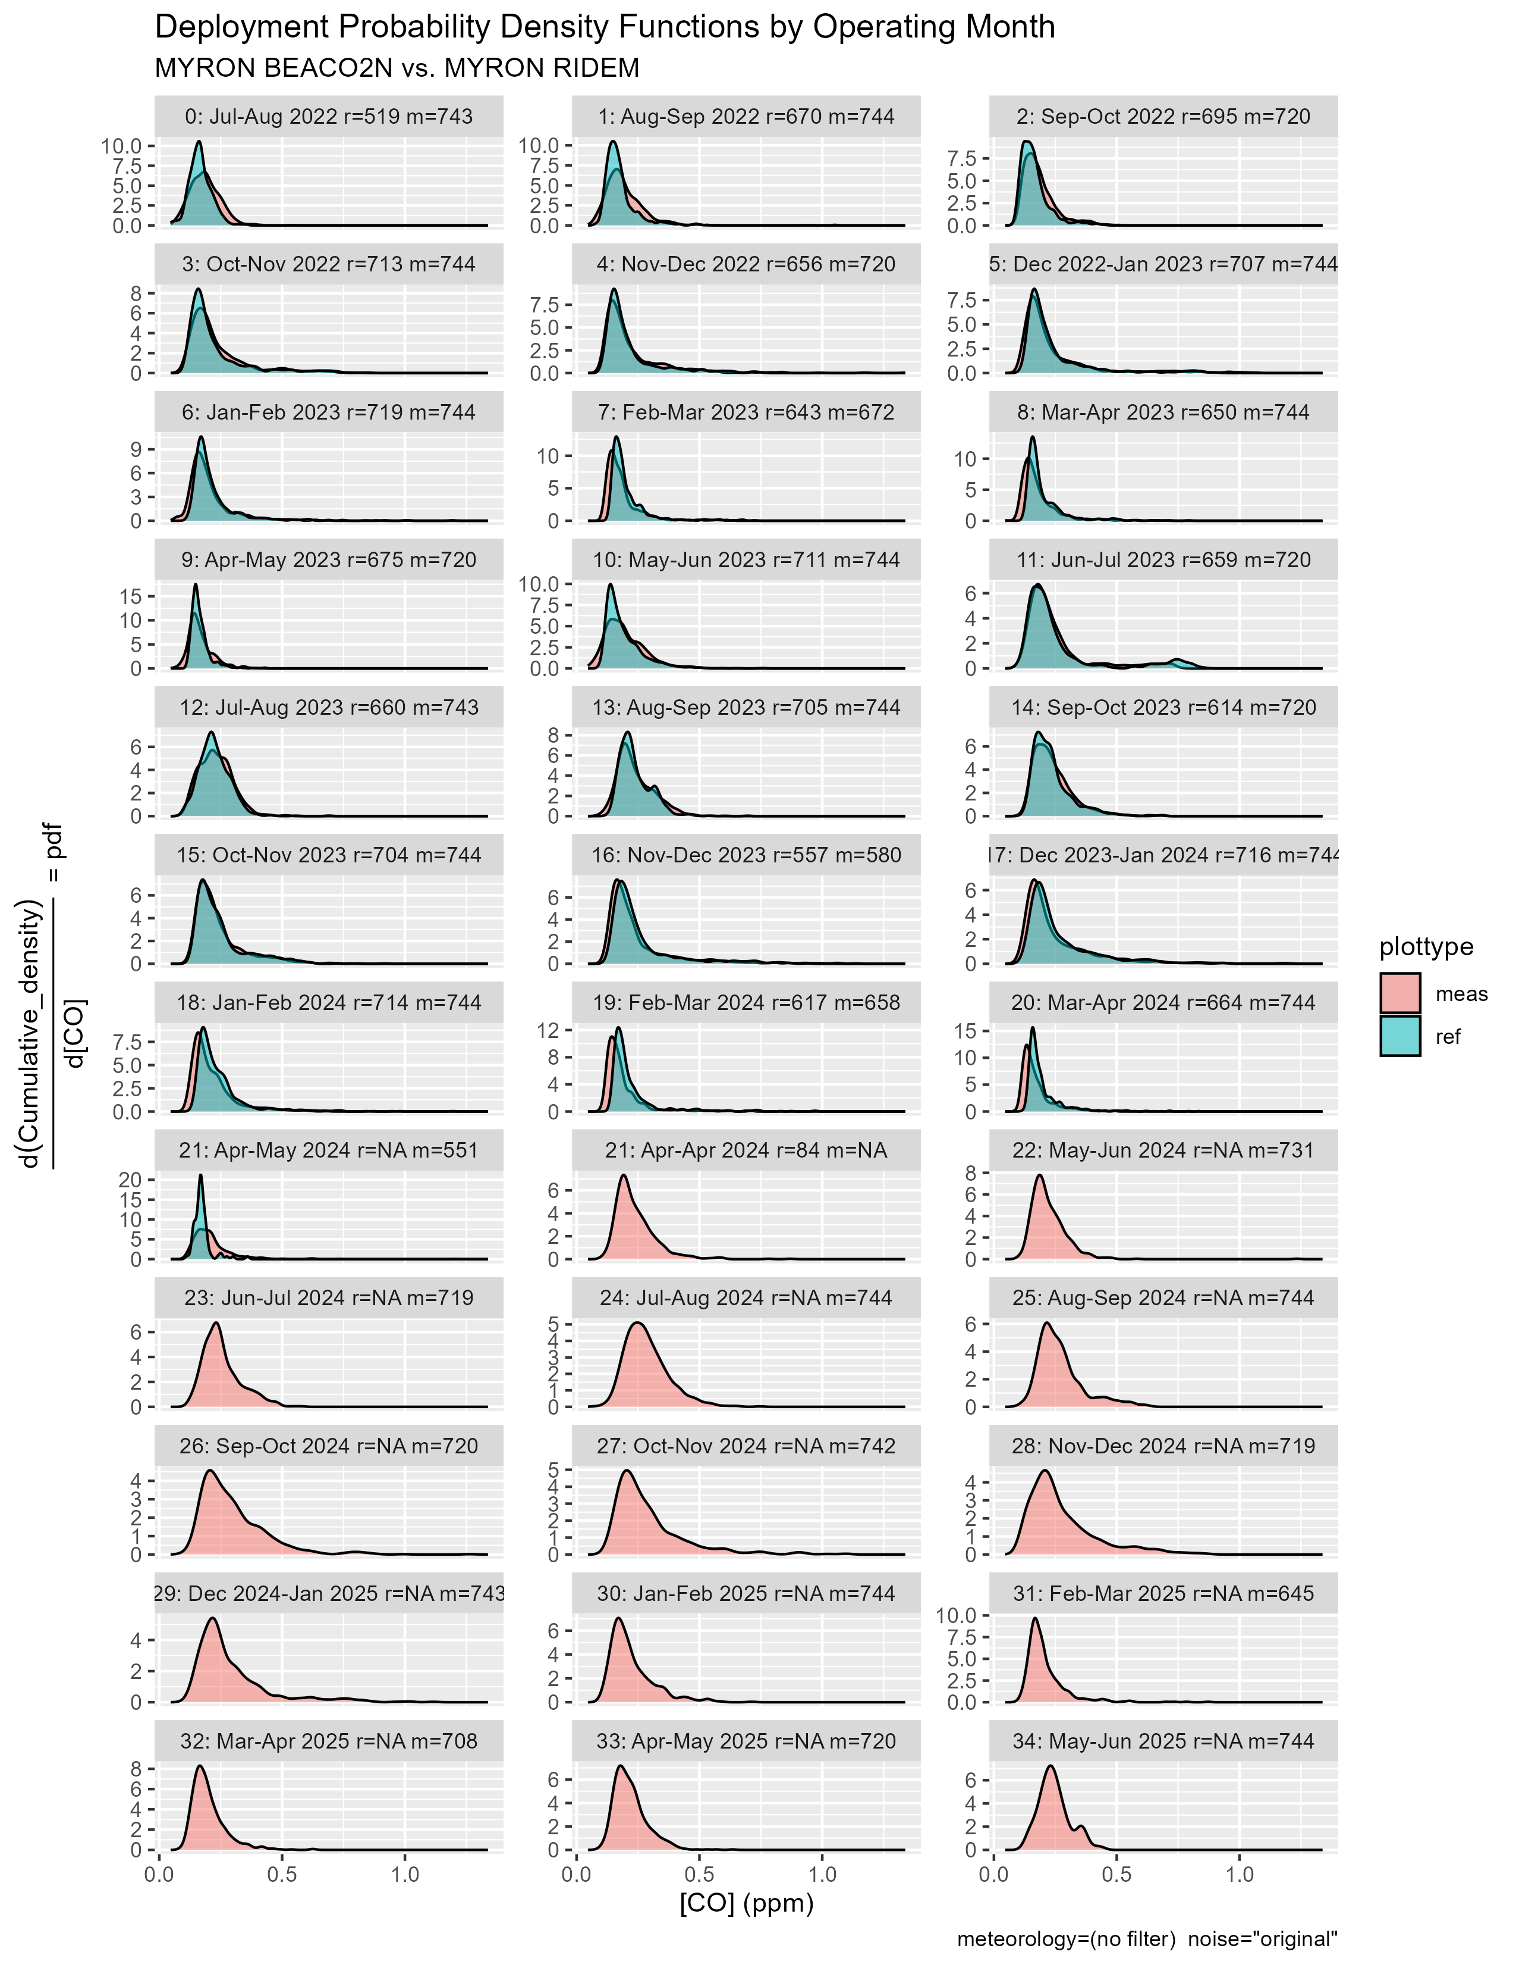
Methods
Sensor degradation should be indicated by a change in the bias or variance of a sensor reading over time compared to reference.
We can assume that the sensor most closely mirrored reference data during its first year of deployment, and that the distribution of pollutant per month does not significantly change.
We can compare a sensor’s distribution of readings at a given month with its distribution at that same month during its first year of deployment.

Slide 5
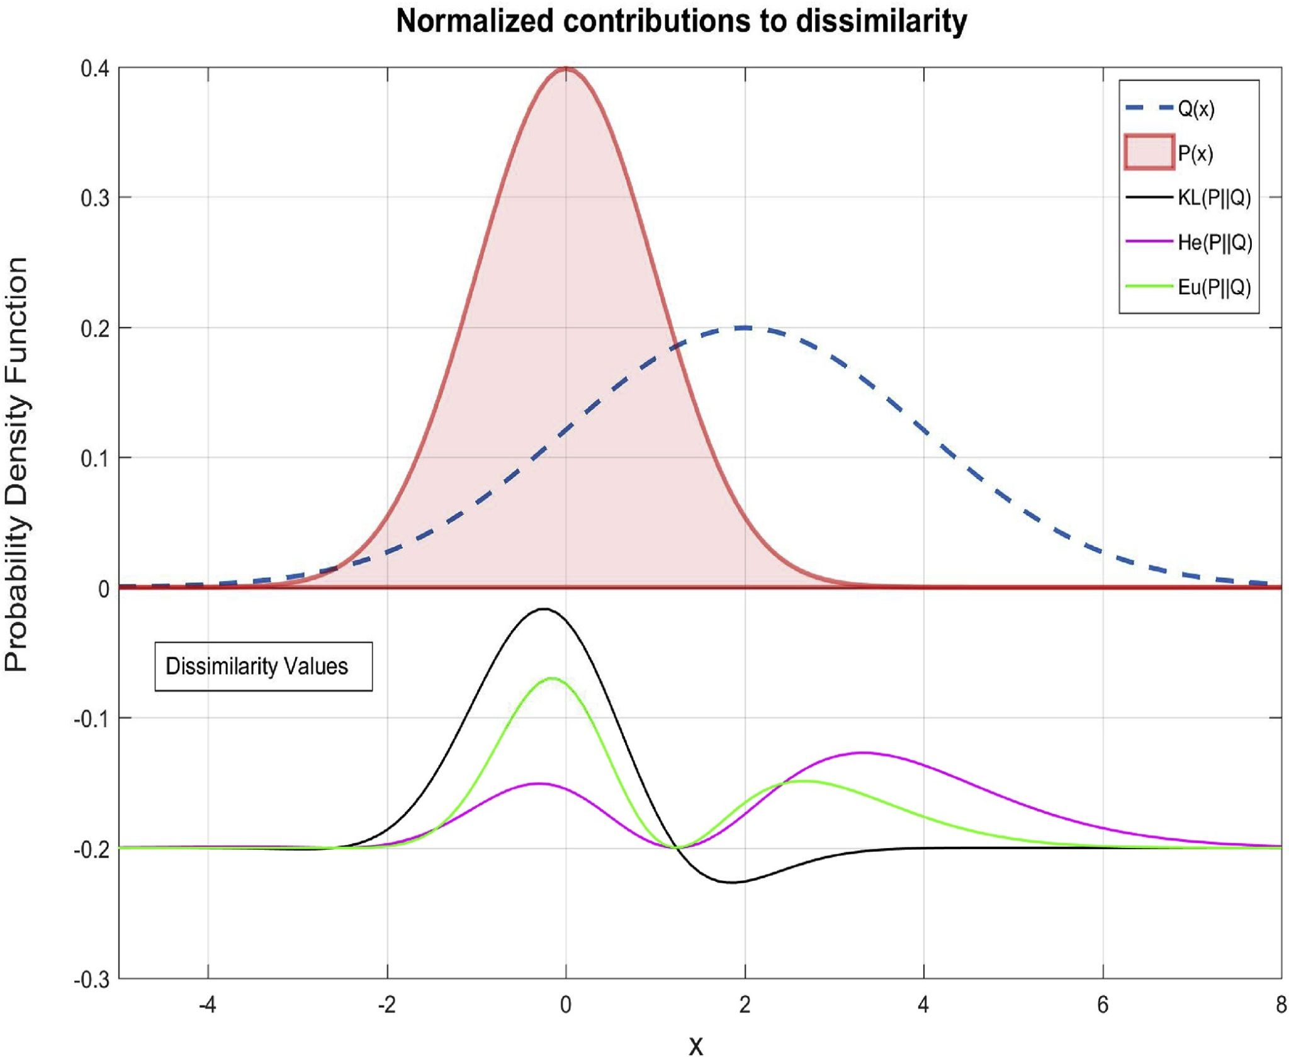
Methods: Quantifying Drift
F-divergences are a family of functions that measure similarity between two probability density functions (i.e. distributions)
Kullback-Liebler divergence:
Measures the “divergence of P from Q”, interpreted as the information lost by using P to approximate Q.
Measured in natural units of information (nats).
Hellinger Distance:
Metric bounded between 0 and 1.
Describes a formal similarity “distance” between distributions, with 1 being most dissimilar.
Related to the amount of area overlap between two distributions.
Euclidean Distance:
Integral of the length of a line from P(x) to Q(x) at all points x.
Integrand values of different f-divergences, scaled and biased for interpretability.
Source: Saverio De Vito, Elena Esposito, Nuria Castell, Philipp Schneider, A. Bartonova, On the robustness of field calibration for smart air quality monitors, Sensors and Actuators B: Chemical, Volume 310, 2020, 127869, ISSN 0925-4005, https://doi.org/10.1016/j.snb.2020.127869. (https://www.sciencedirect.com/science/article/pii/S0925400520302161)

Slide 6
Myron as Control Experiment
Myron J. Francis has the longest collocation period with a reference sensor.
Can apply Winter framework and self-degradation framework as control.
Then extend self-degradation framework to sites without RIDEM reference data.

Slide 7
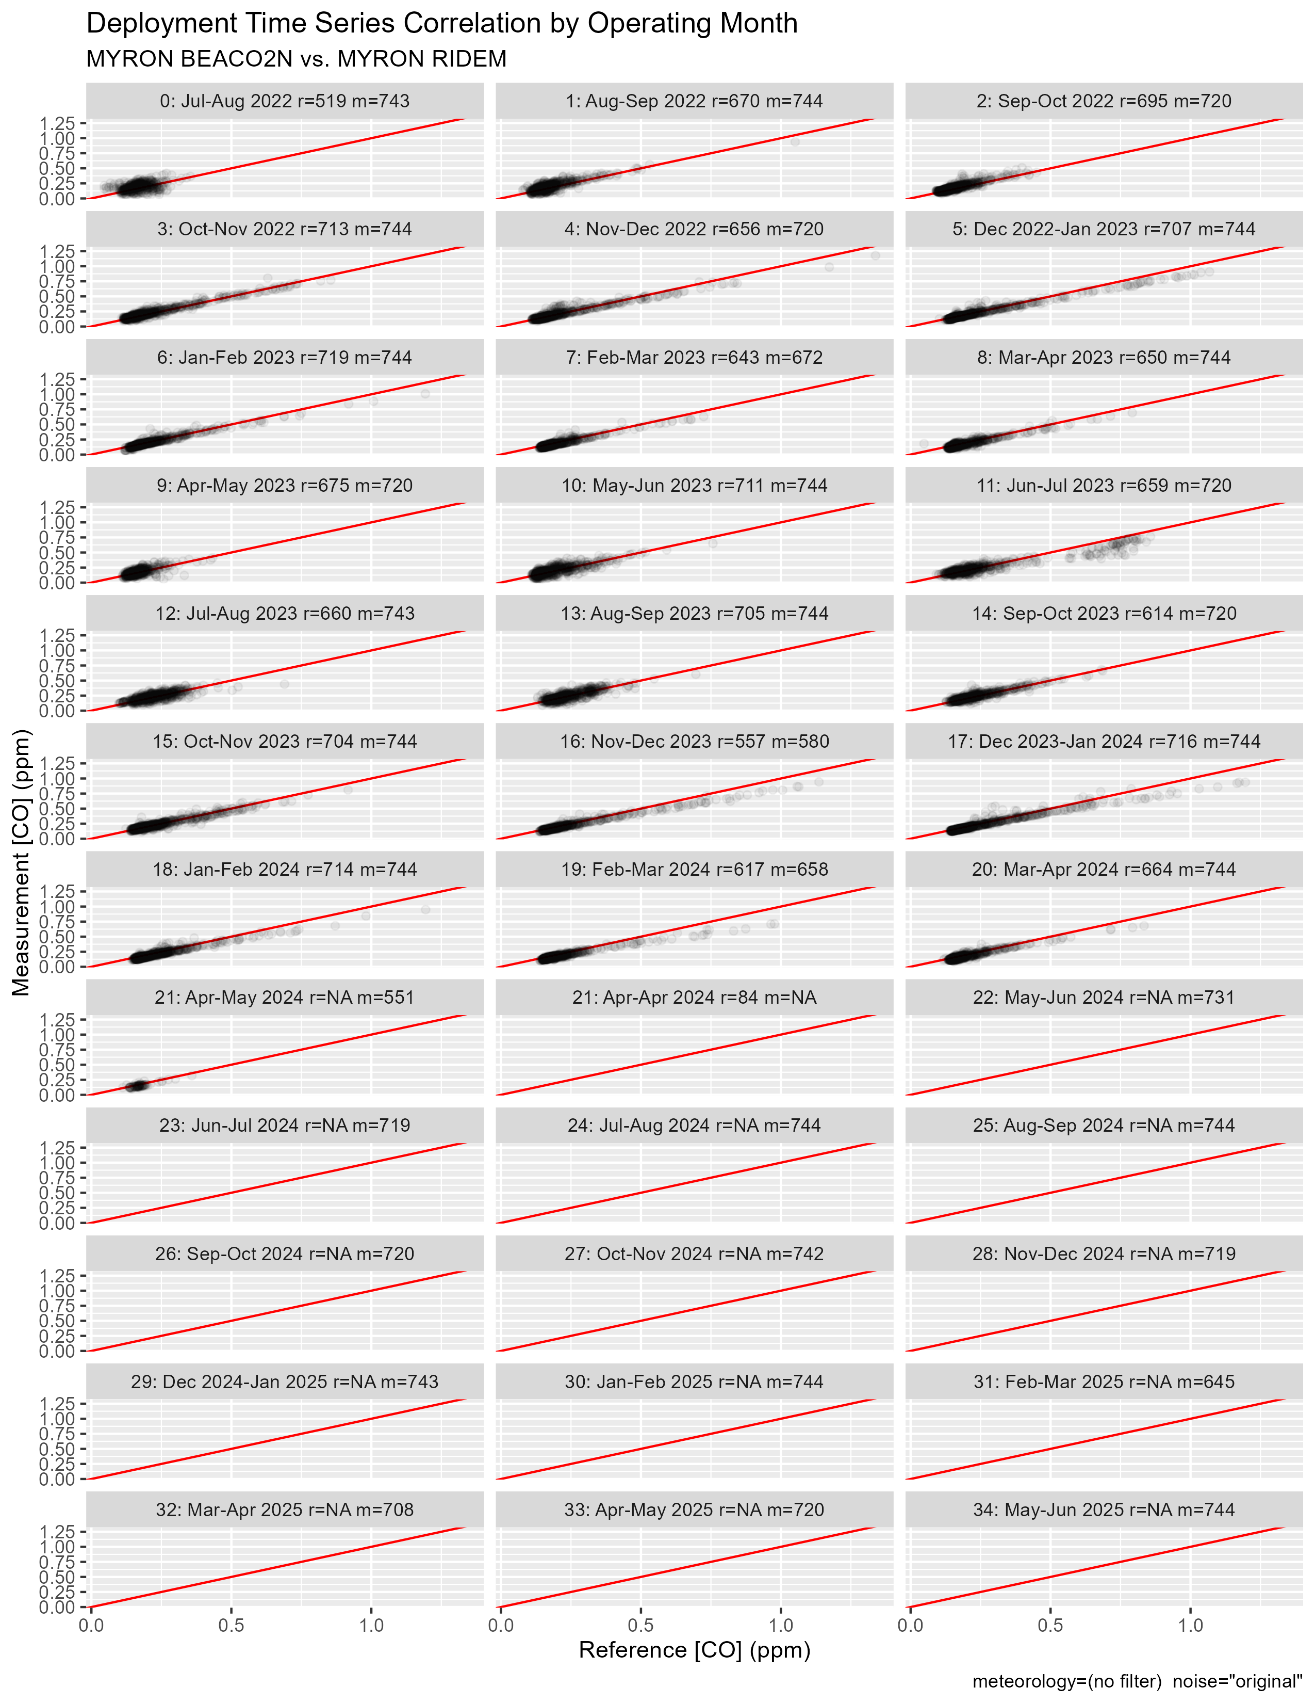
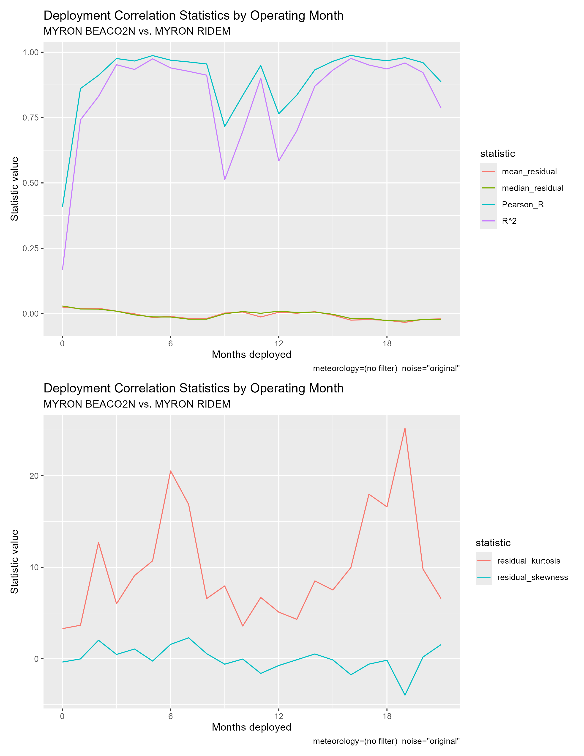
Myron BEACO2N vs. RIDEM: No meteorological filtering

Slide 8
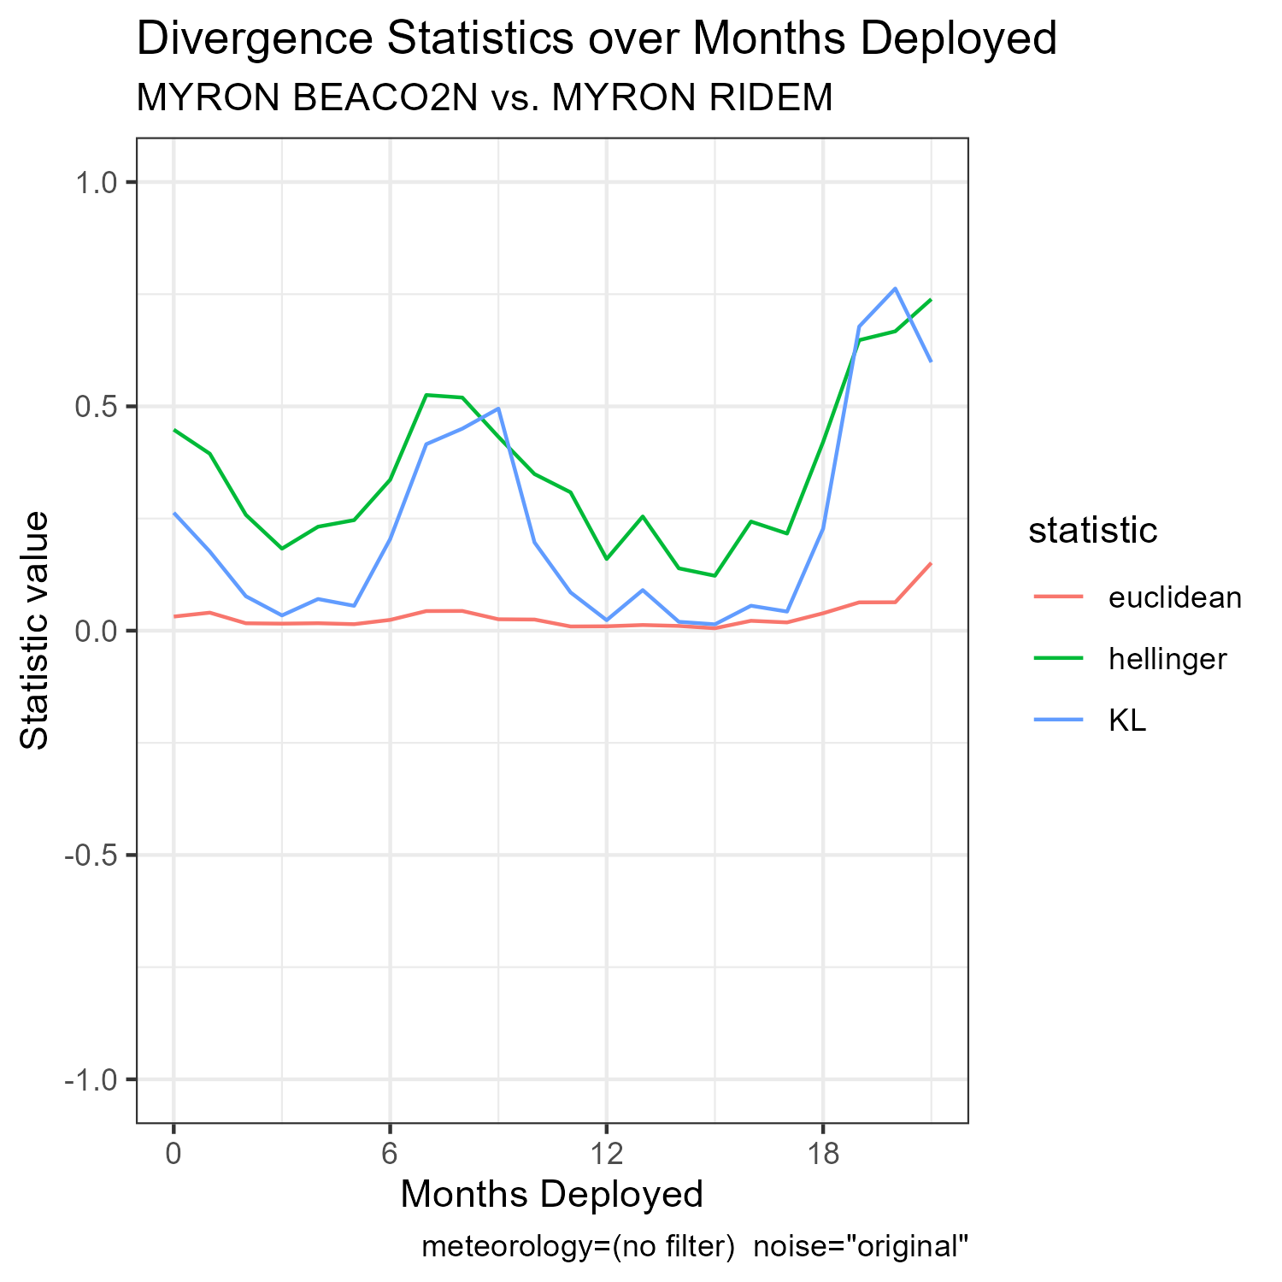
Myron BEACO2N vs. RIDEM: No meteorological filtering

Slide 9
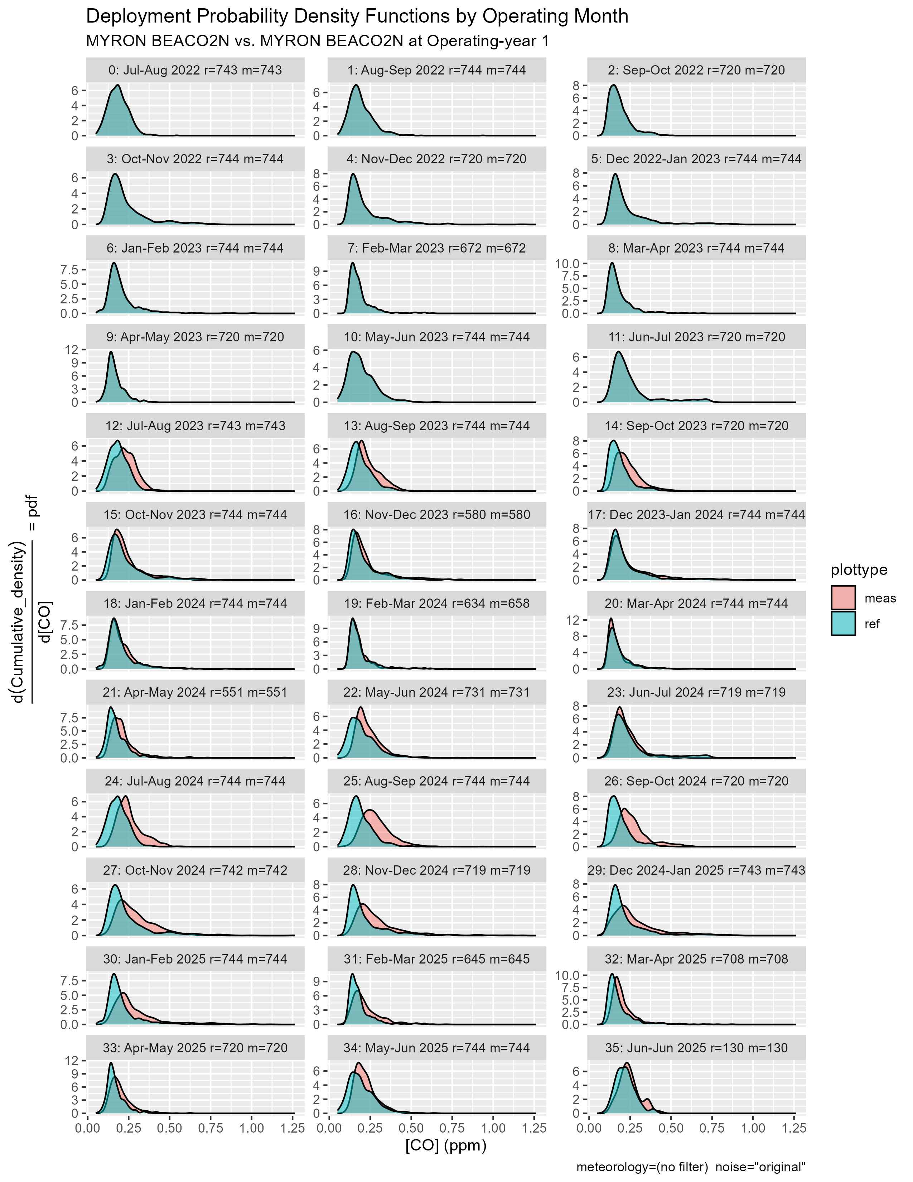
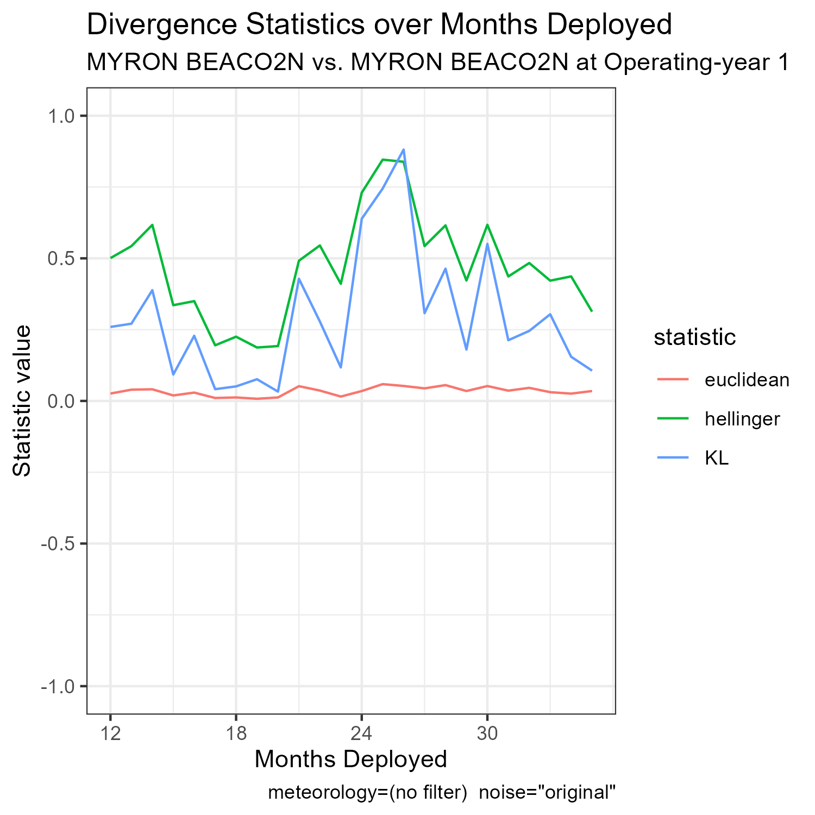
Myron BEACO2N vs. Self at Year 1: No met. filtering

Slide 10
Observations
We see that divergence spikes during summer months and does not return to low level it was at before summer spike.
Hypothesis: Sensor performance at strenuous meteorological conditions degrades more rapidly over time than sensor performance at normal meteorological conditions.
“Strenuous meteorological conditions” are temp>30C or rh>0.75

Slide 11
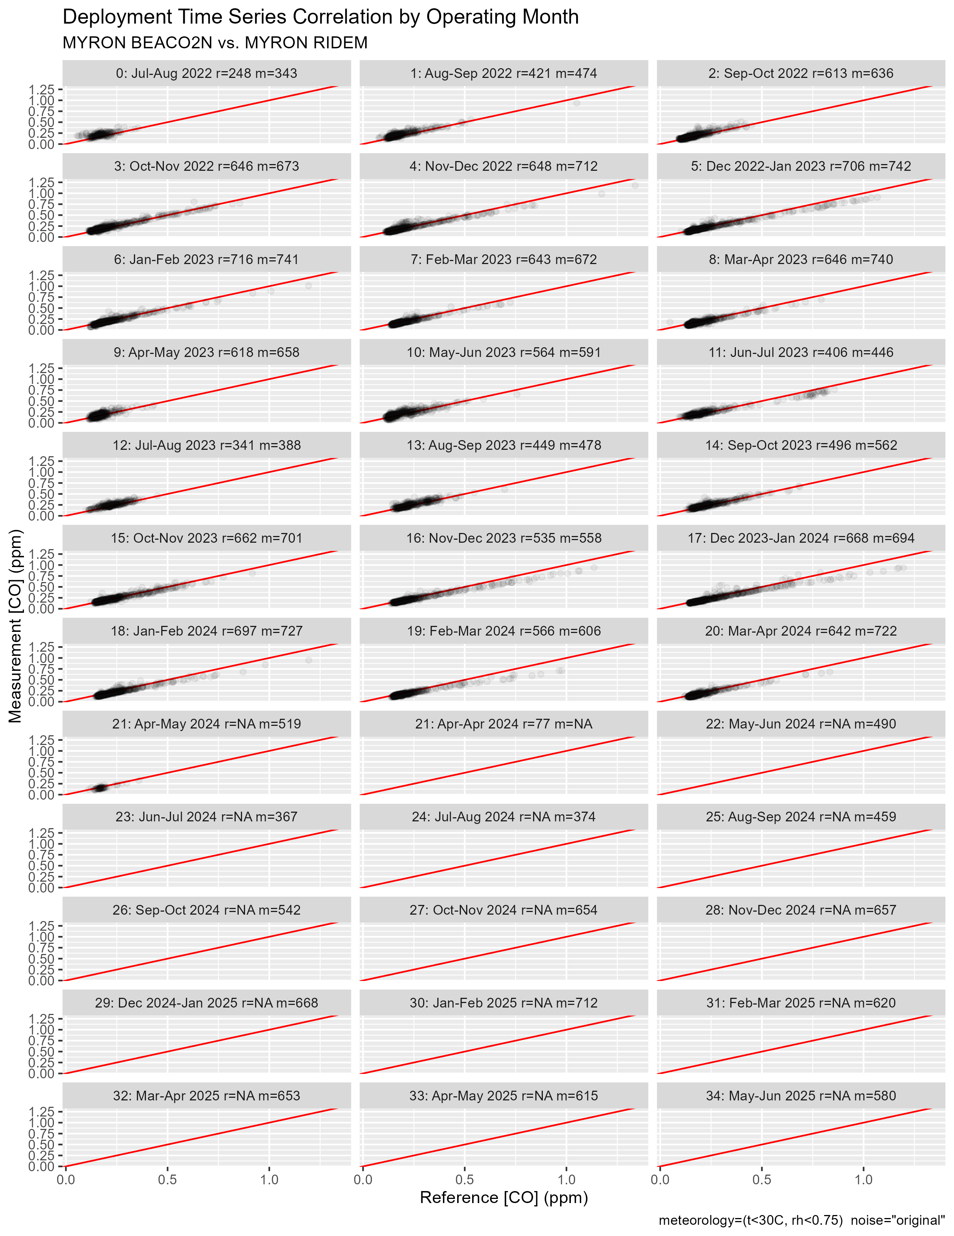
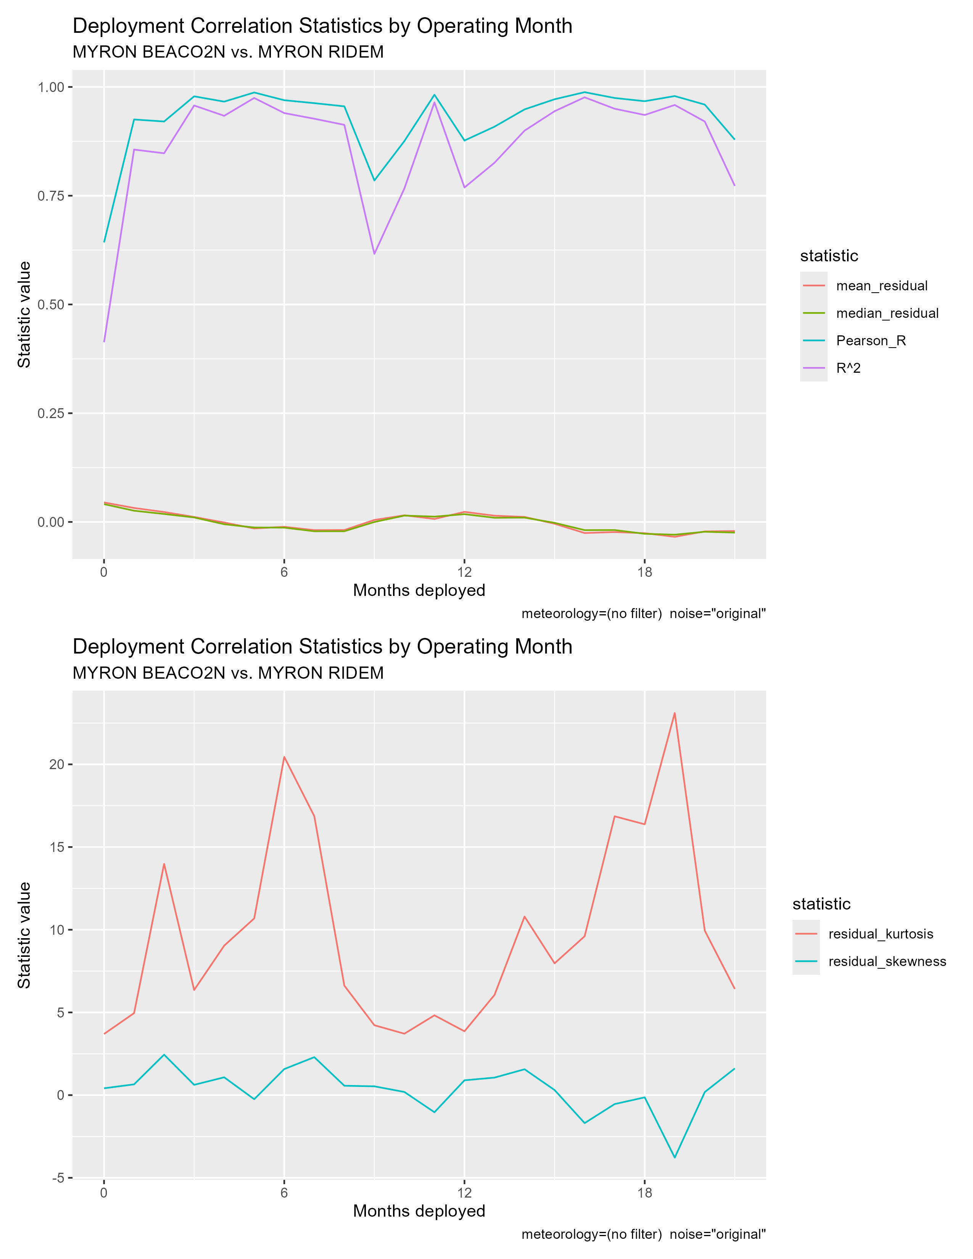
Myron BEACO2N vs. RIDEM: with met. filtering
←Meteorology filter is mislabeled on this graph, should say (t<30C, rh<0.75). Plotted data is properly filtered.

Slide 12
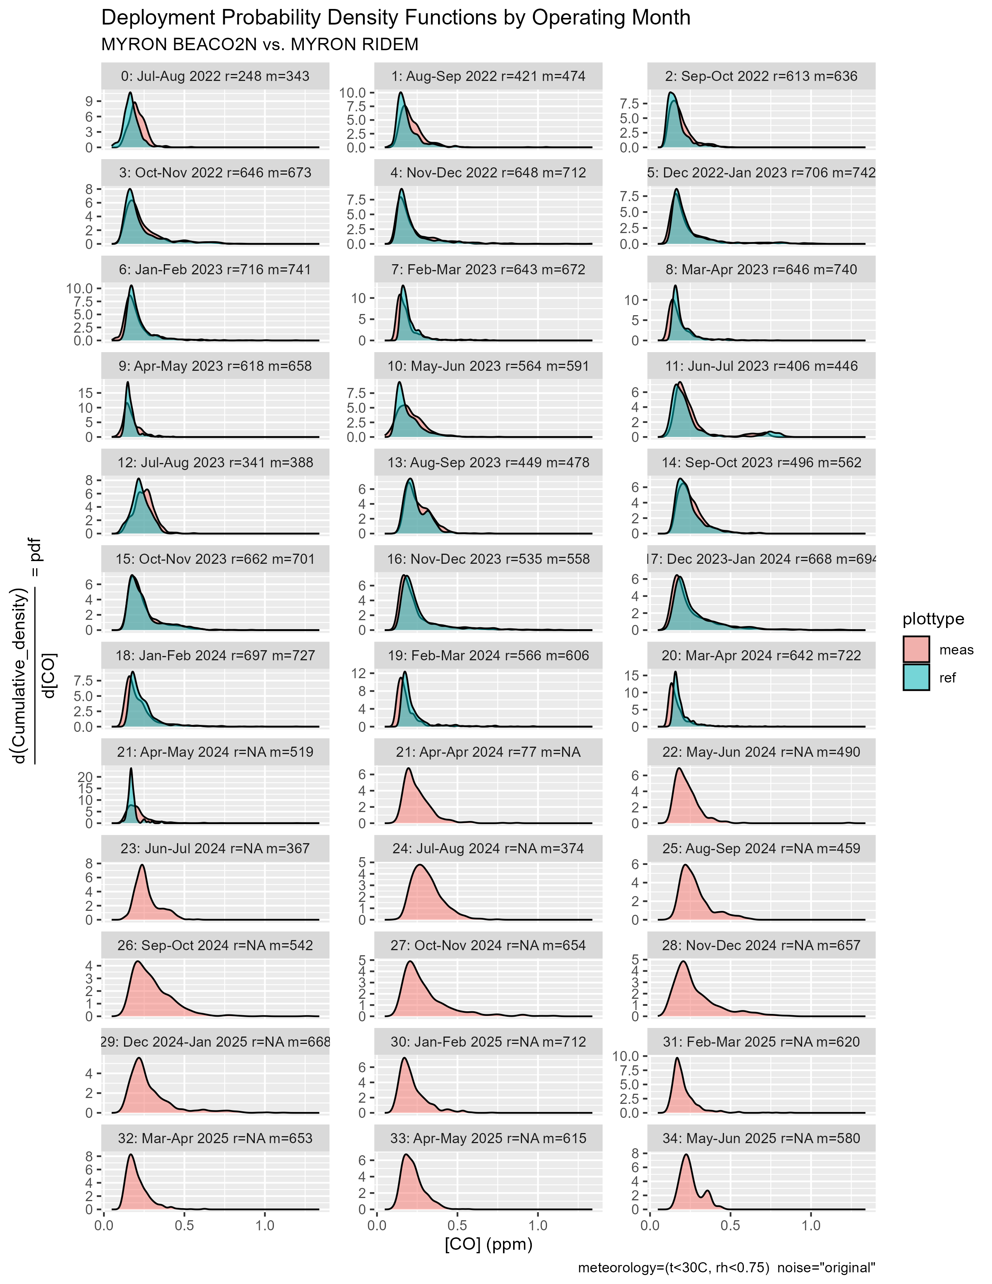
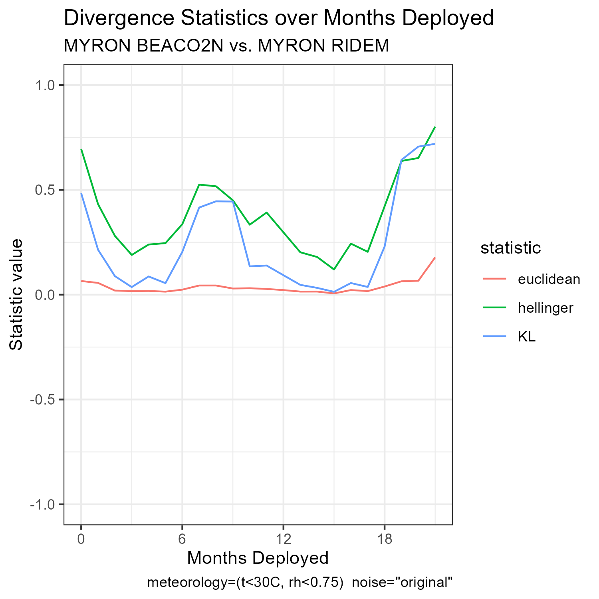
Myron BEACO2N vs. RIDEM: with met. filtering

Slide 13
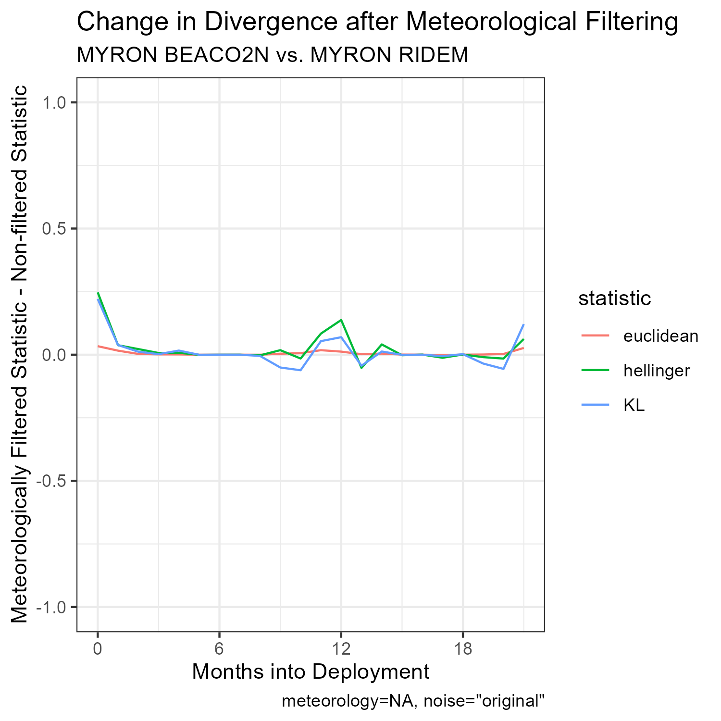
Myron BEACO2N vs. RIDEM: with met. filtering

Slide 14
Observations
At ~12 mos of deployment, information loss increases as result of meteorological filtering.
This may indicate that for the first operating year, BEACO2N sensors perform reasonably well at strenuous meteorological conditions and are aligned with reference measurements.
May also just be noise…

Slide 15
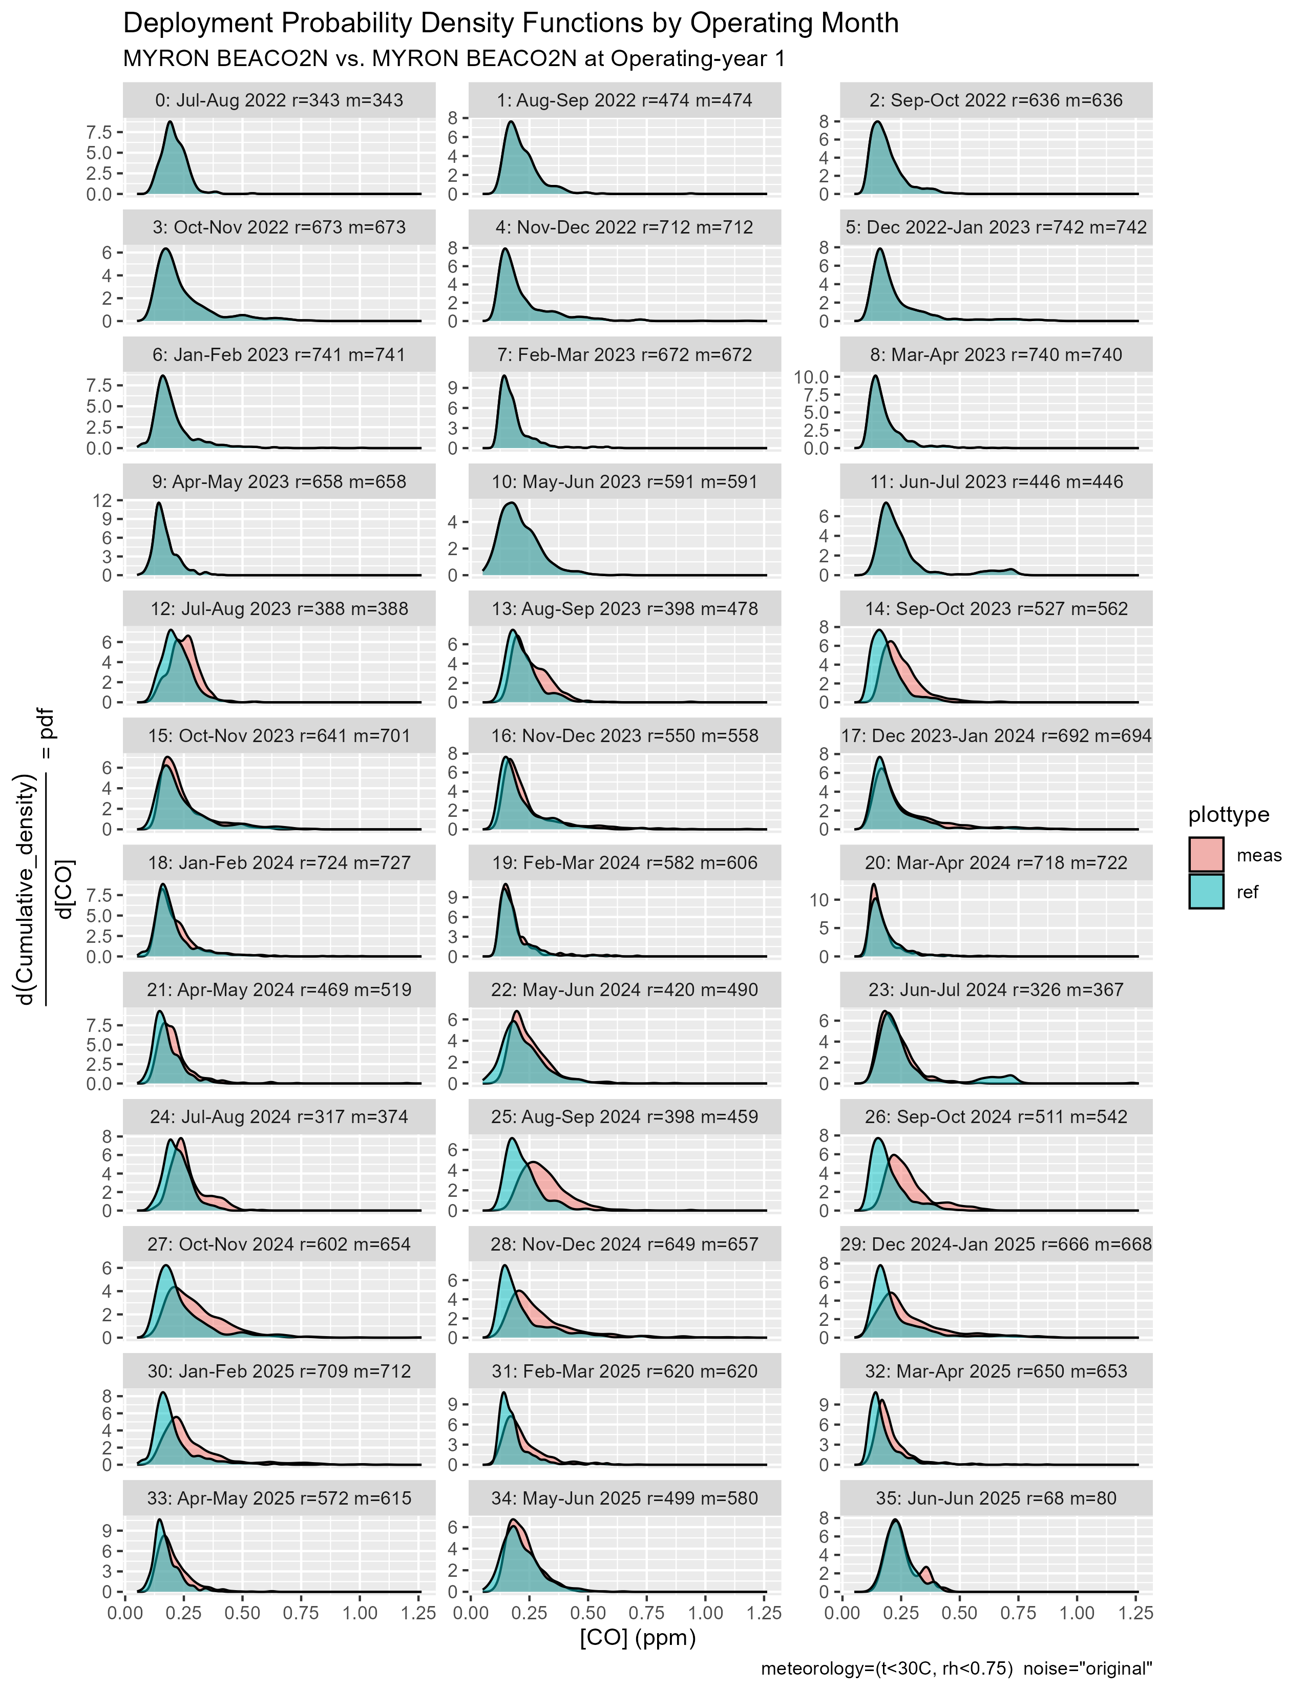
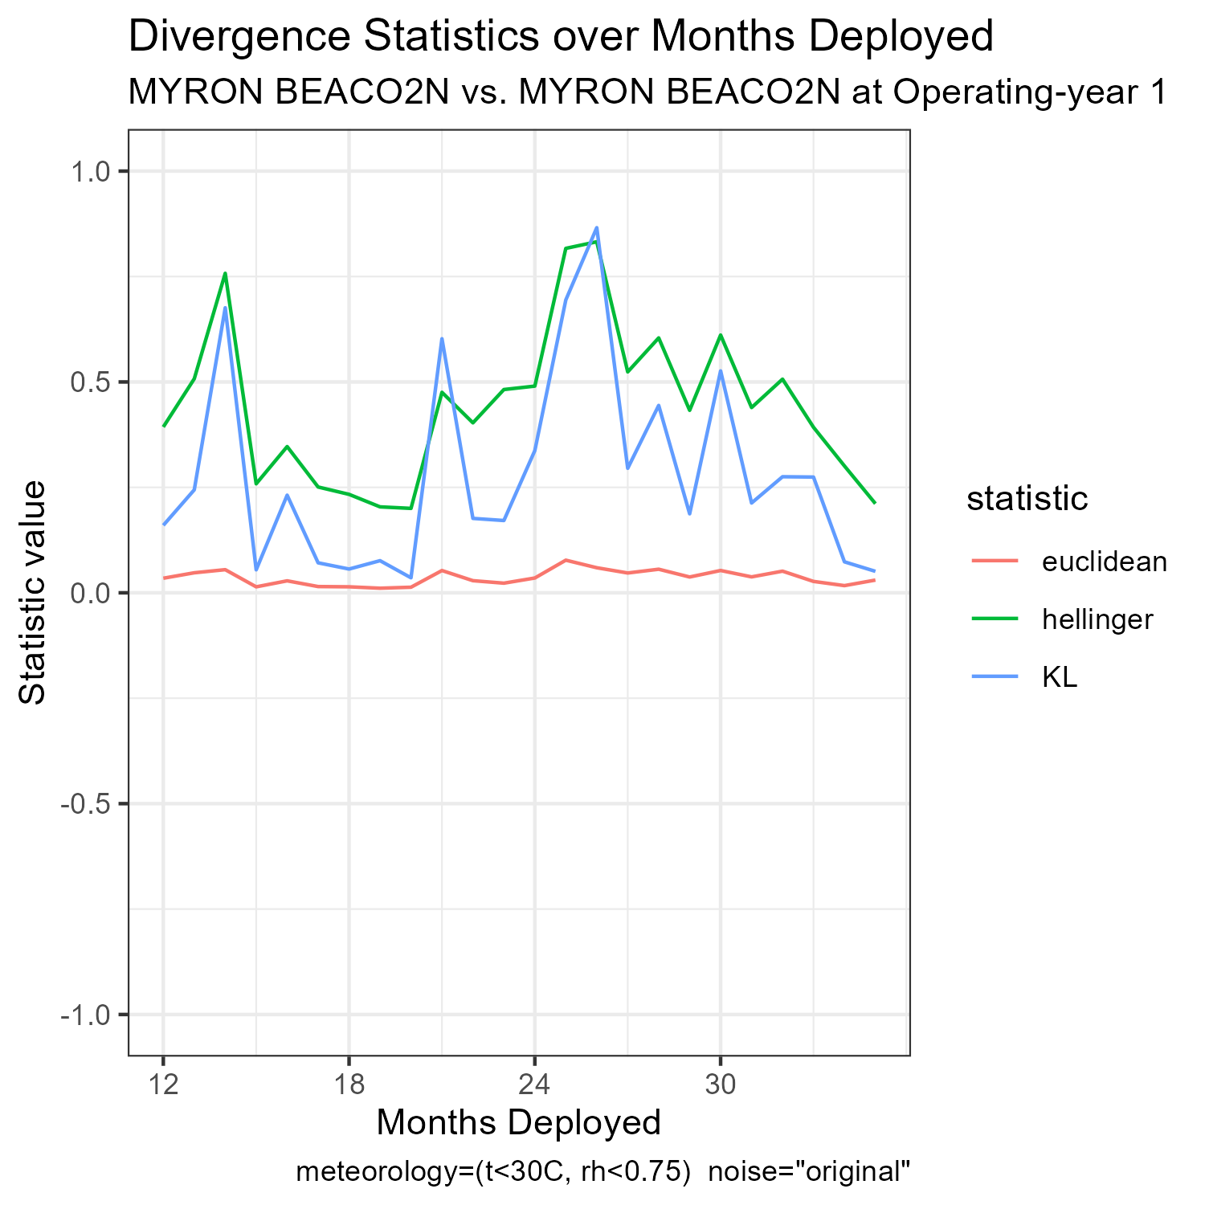
Myron BEACO2N vs. Self at year 1: with met. filtering

Slide 16
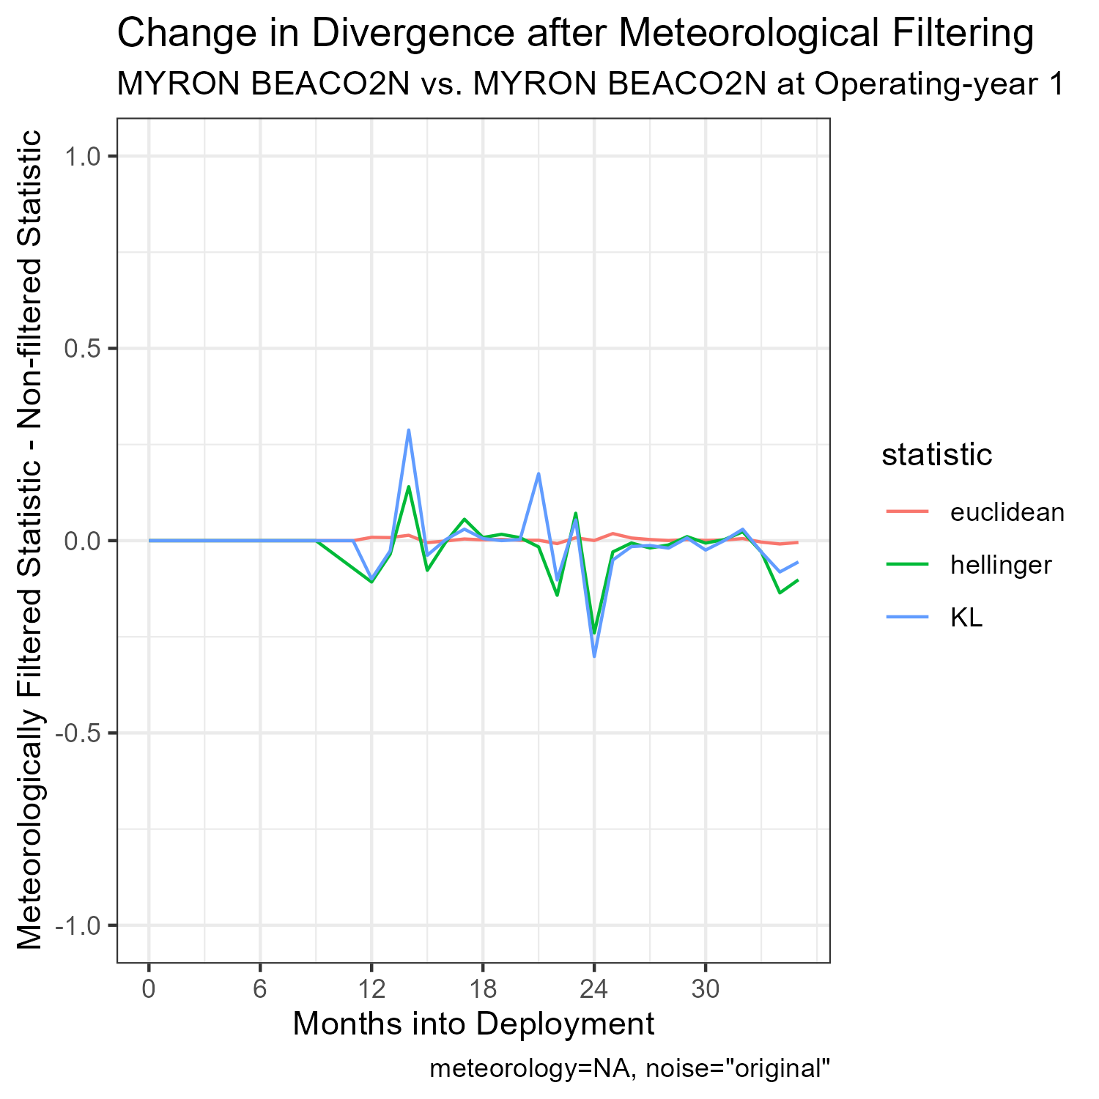
Myron BEACO2N vs. Self at year 1: with met. filtering

Slide 17
Observations
Information loss again increases at ~12 mos but decreases at ~24 mos (both summertime)
May indicate that sensor performance at strenuous meteorological conditions degrades over time.
We know that sensor performance during summer months is always less correlated with reference data than during winter months. In terms of this framing, our alternative hypothesis would mean that this poor correlation becomes worse with time.

Slide 18
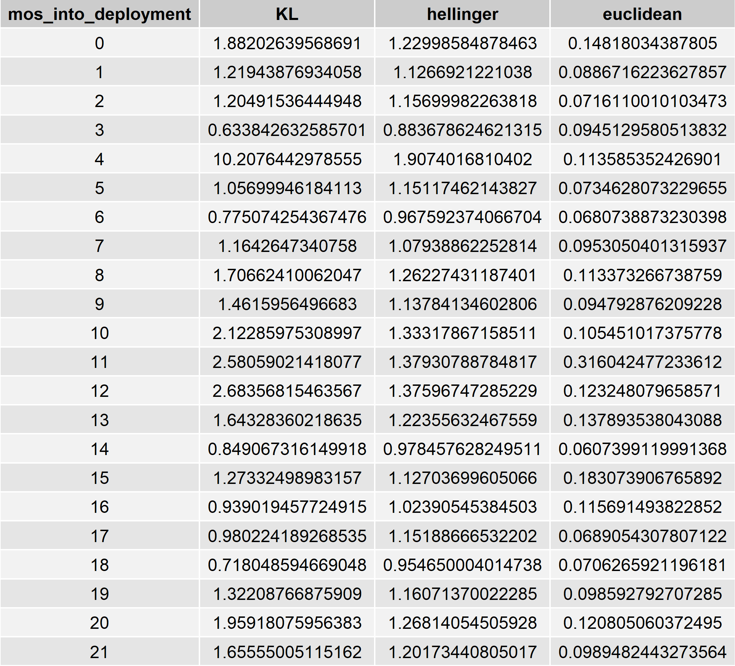
Issues with Generalizing this Method:
Many site plots exhibited data artifacts or program errors during script execution…
Sites that explicitly returned a program error: rochambeaulib, zuccolo, smithhilllib, pema, rockspot
Artifacts appear to mainly be contained to comparisons with reference data.
Blackstone Divergences vs RIDEM Cranston without met. filtering

Slide 19
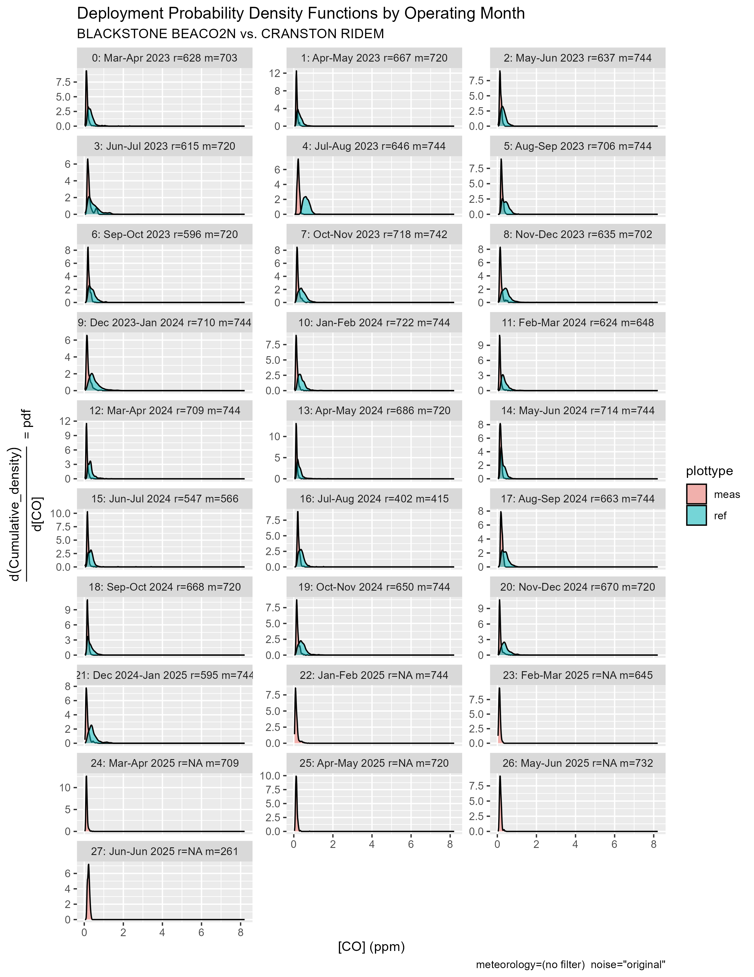

Slide 20
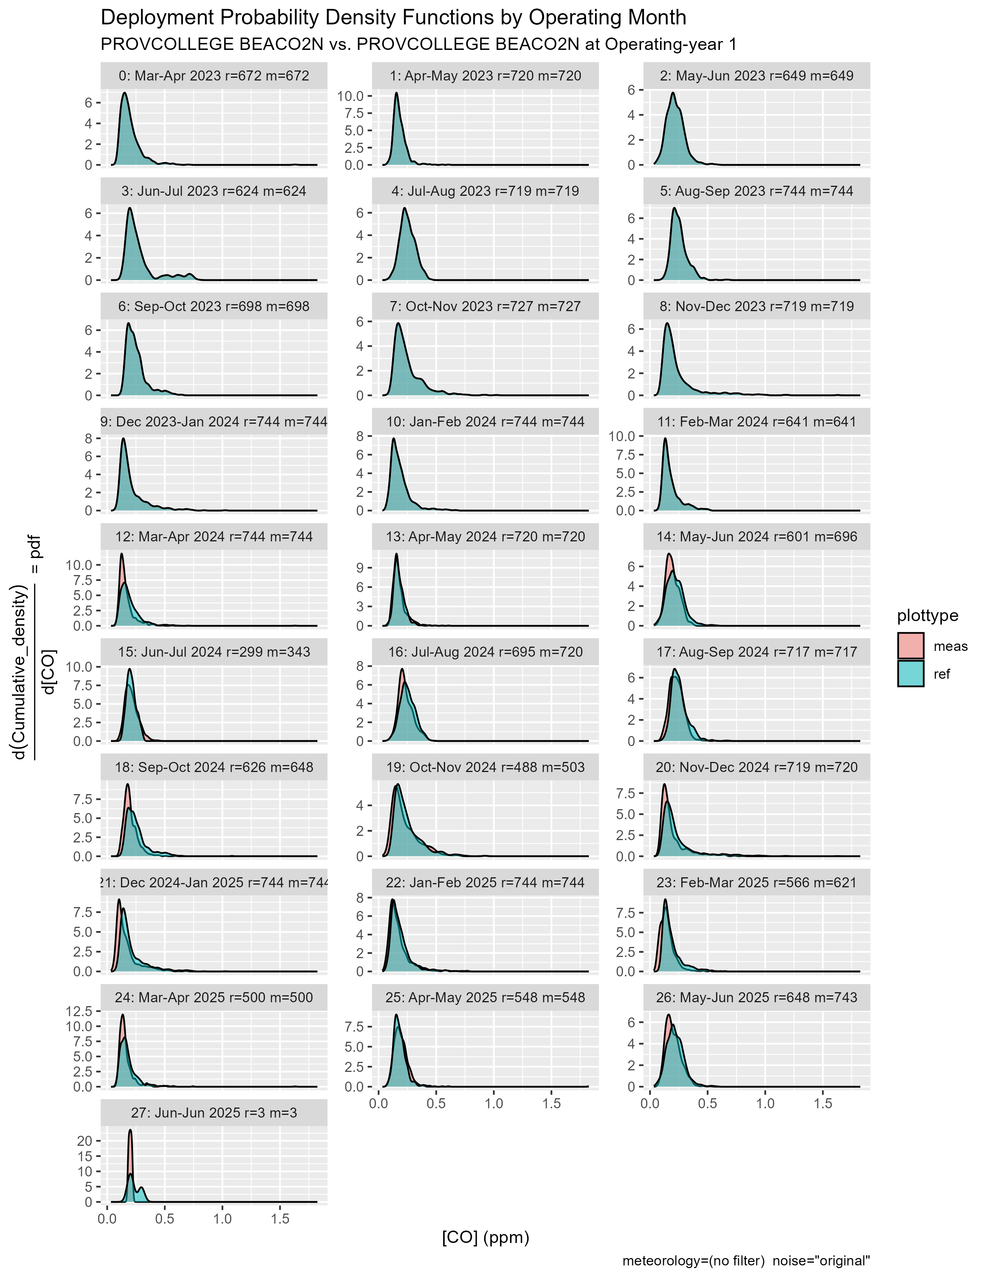
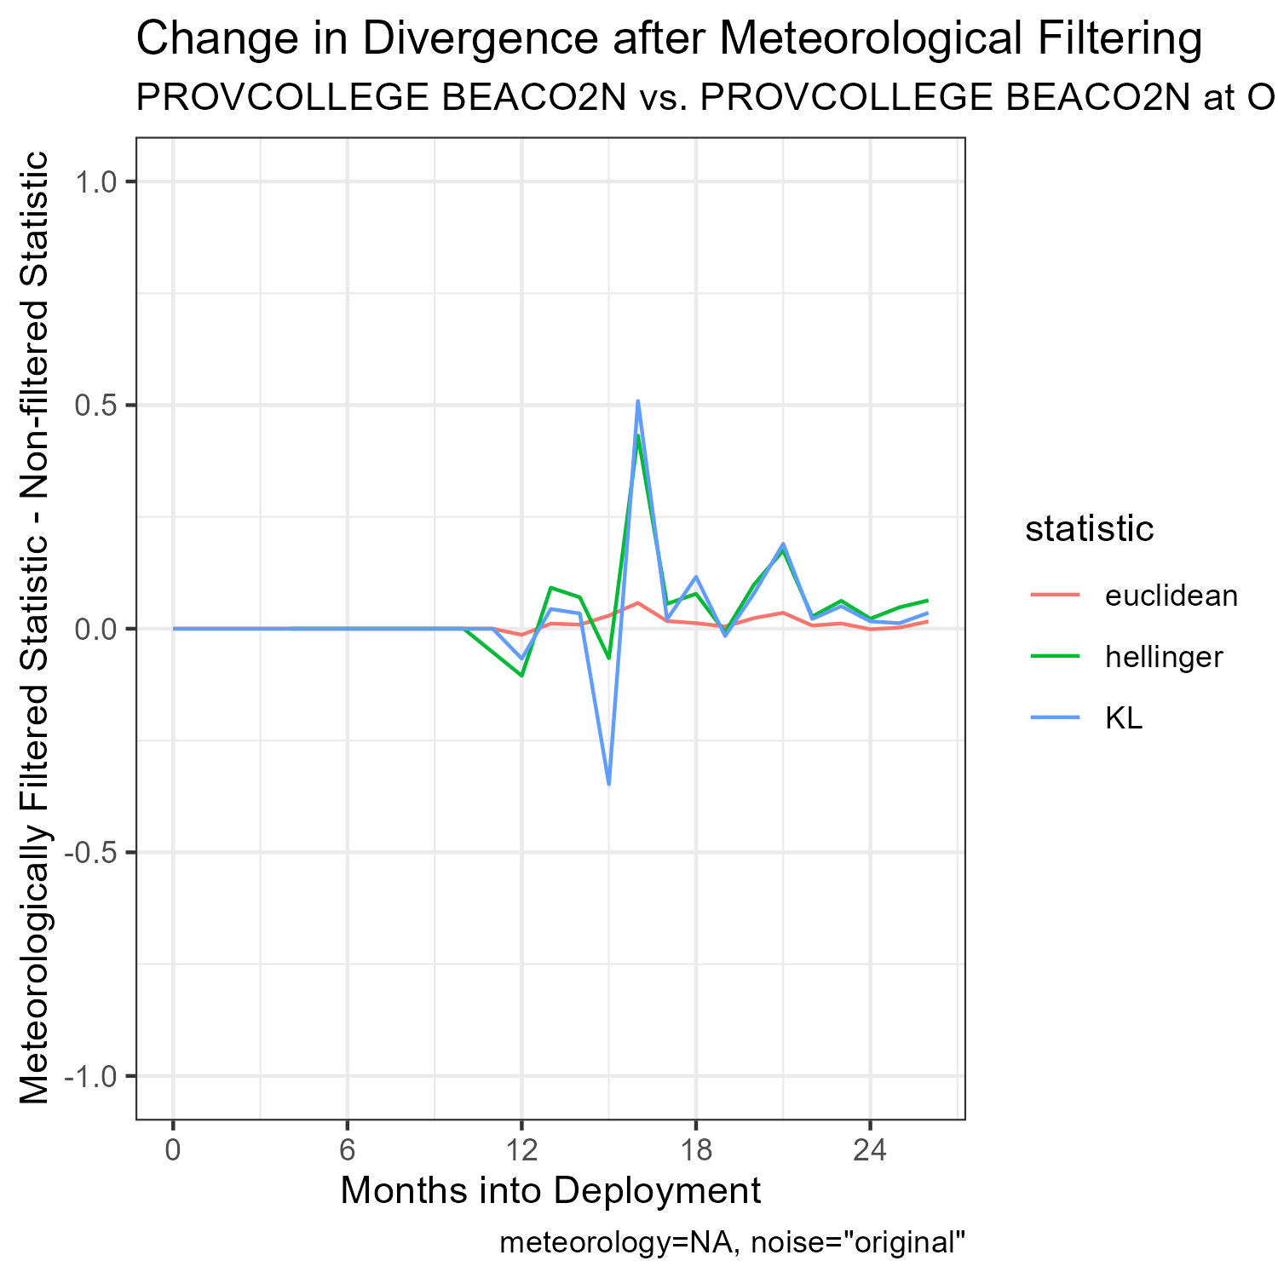
No information gain at ~24 mos for Providence College

Slide 21
No information gain at ~24 mos for Providence College

